Slide 1
Paul Harris Society
Bart Purnal

Slide 2
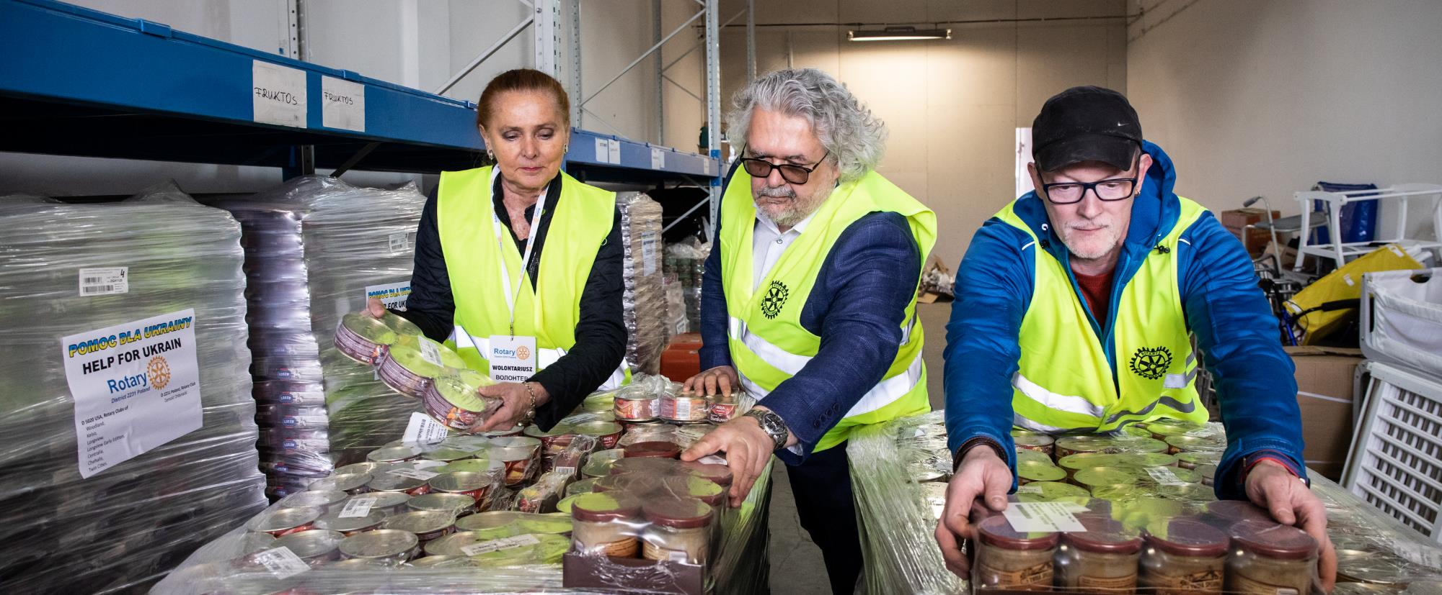
Paul Harris Society
Philanthropic leaders dedicated to positive change
Notes:
Rotary has a history of more than 100 years of serving communities near home and around the world. Your continued support of The Rotary Foundation brings lasting and positive change to communities in need and inspires others to join us in Doing Good in the World.

Slide 3
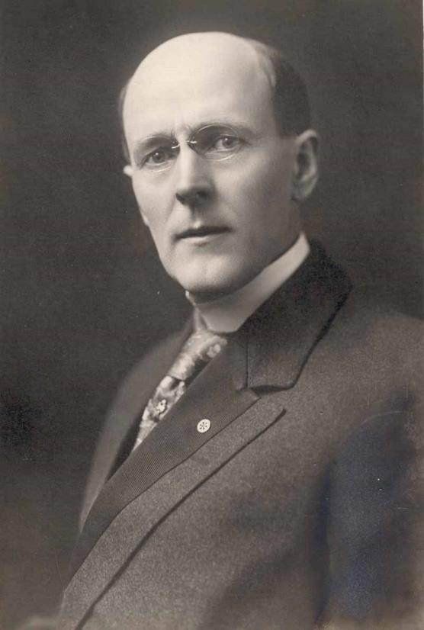

Paul HARRIS SOCIETY
Title Page Option

Slide 4

Club-Bijdragen
100 $ per lid per jaar

Slide 5
Individuele Bijdragen
Heeft u daar al eens aan gedacht?

Slide 6












subhead
Iedereen heeft wel al eens gedoneerd aan:

Slide 7

subhead
Maar wie heeft al eens persoonlijk gedoneerd aan…

Slide 8
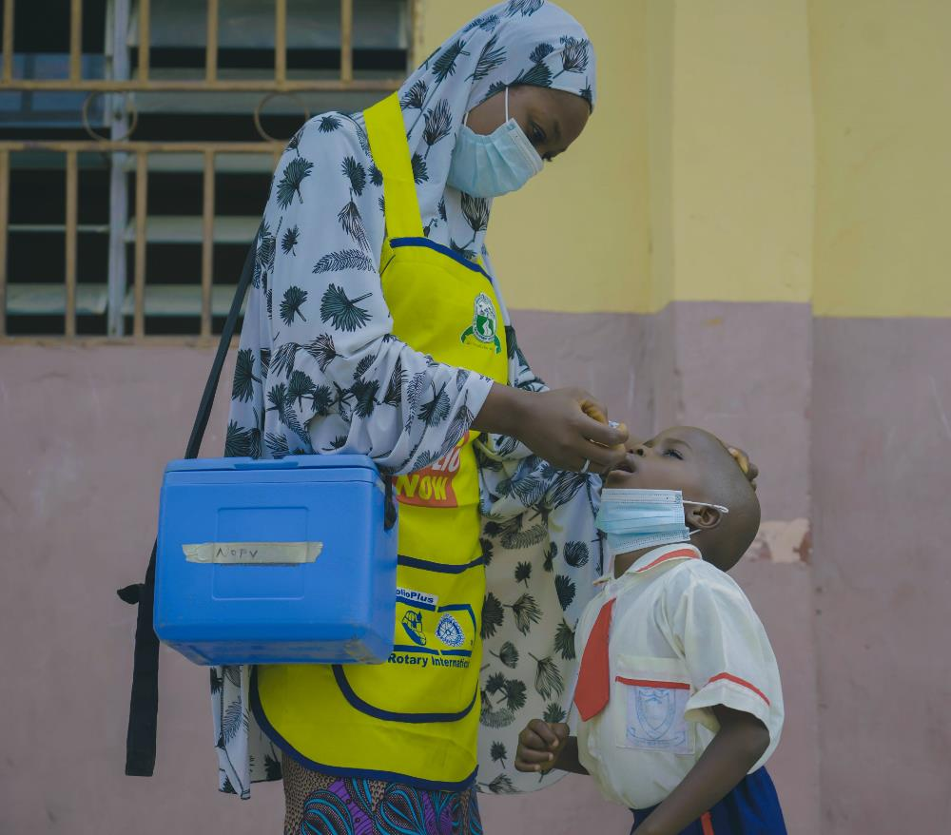

Paul Harris society
What is the Paul Harris Society?
A dedicated group of donors who inform
The Rotary Foundation of their intent to contribute US$1,000 or more every year to any of these:
The Annual Fund
The PolioPlus Fund
Approved global grants
Notes:
The Paul Harris Society is a giving society of more than 30,000 donors worldwide. PHS recognizes donors who notify the Foundation that they intend to contribute US$1,000 or more every year to the Annual Fund, the PolioPlus Fund, or approved global grants.
This recognition was administered by districts until the society became an official Rotary Foundation program in 2013. Its purpose is to identify, engage, and recognize members who want to make substantial annual gifts to help others.
Optional background:
Past District Governor Wayne Cusick from District 5340 created the Paul Harris Society. Cusick realized that giving $1,000 annually to the Foundation was not possible for every Rotarian, but many could contribute that much or more. He introduced PHS to encourage and recognize them. The idea quickly spread to other districts. Quick facts about PHS:
It began in 1999 in California, USA.
It grew under the leadership of Wayne Cusick.
It specifies committing $1,000 annually to an immediate-use designation.
It was adopted as official recognition by The Rotary Foundation 1 July 2013.
Wayne Cusick began a mid-level donor loyalty program that:
Cultivates ongoing 1-to-1 relationships with donors
Encourages donors to commit to future giving
Creates a field of prospective donors of major gifts and estate gifts

Slide 9
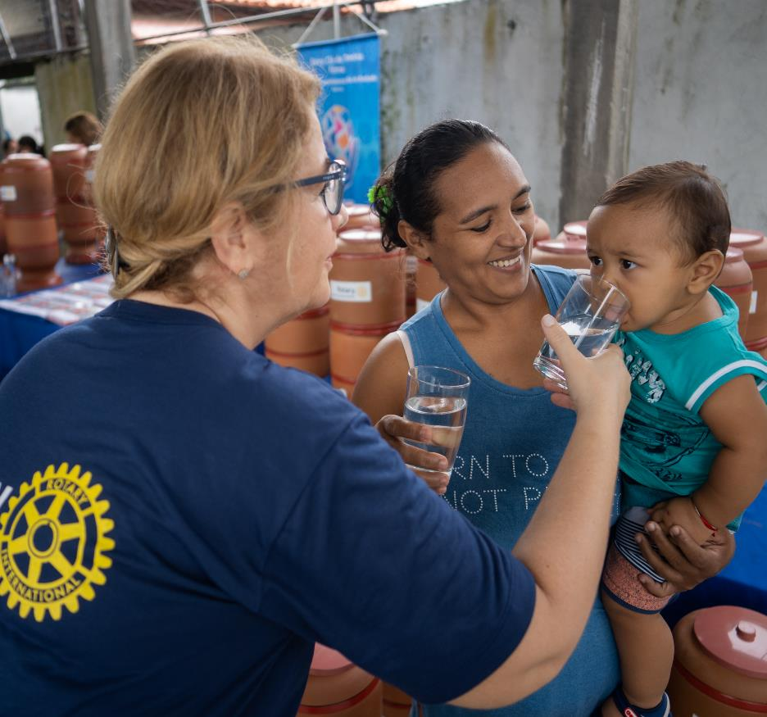



PAUL HARRIS SOCIETY
Why should I join the society?
You are dedicated to making a difference
  Support Rotary Foundation programs
You want to inspire fellow Rotary members
  Be a leader in philanthropy in your community
You want to achieve philanthropic goals
  Earn donor credit and recognition for your gifts
Notes:
The Paul Harris Society is a vital community of donors. The more than $30 million they contributed in 2021-22 accounted for nearly 21% of that year’s donations to the Foundation's Annual Fund. They gave $41 million to the Foundation in all. That’s nearly 20% of our overall donations.

Slide 10
PAUL HARRIS SOCIETY
Who are the society’s members?
Globally, more than 30,000 people belong to this giving society. These dedicated donors share a desire to give substantially and empower Rotary members to change lives in their communities and around the world.
 | Country | Members
1. | United States | 14,938
2. | Korea | 5,285
3. | India | 1,432
4. | Japan | 1,272
5. | Canada | 1,037
6. | Philippines | 1,002
7. | Taiwan | 903
8. | Australia | 651
9. | Brazil | 544
10. | Mexico | 336

Slide 11


8 Focus-
gebieden

Slide 12

Wat gebeurt er met mijn geld? Een voorbeeld : Peace centers
Rotary Peace Center at
Makerere University, Uganda
40 Fellowships
Program on Peace / Conflict
50/50 Men/Women
50/50 Africa/World
Uppsala University, Sweden
50 fellowships
Program on Water/Peace/Conflict
Doing Good in the World

Slide 13
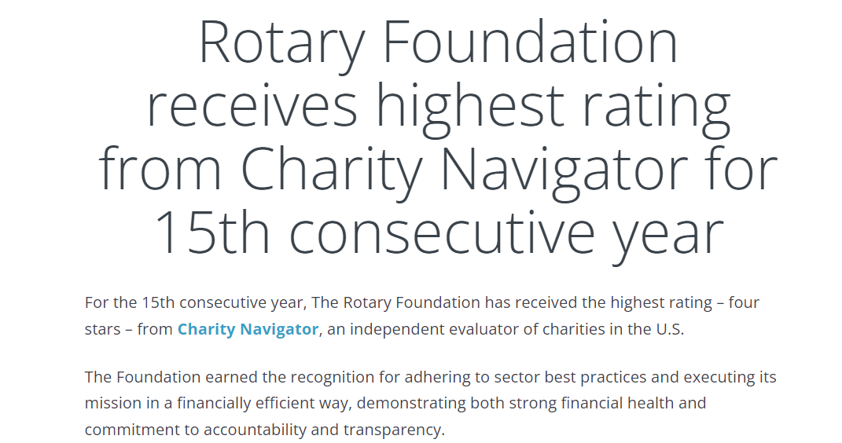
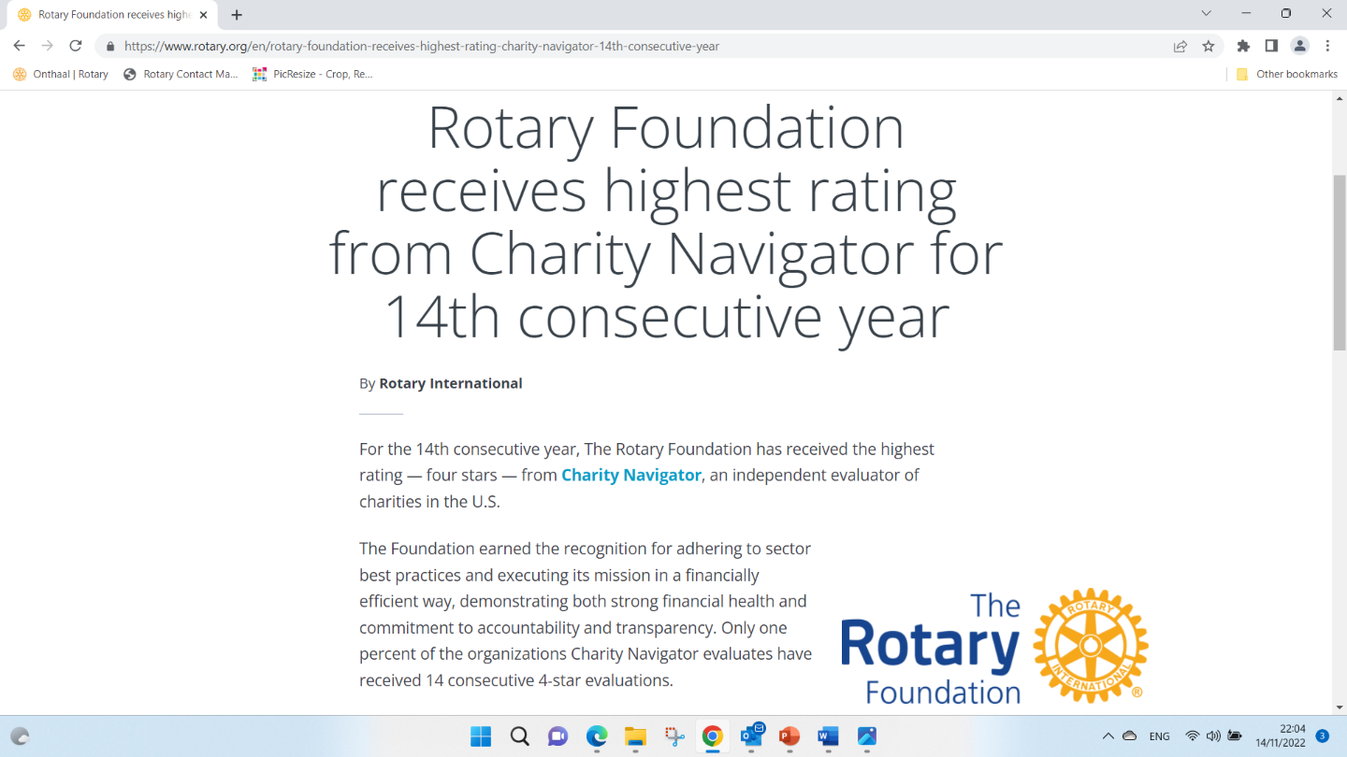
Charity navigator

Slide 14
PHS-donoren kunnen elk jaar hun 1000 $ investeren in:
Hoe ?
  Annual Fund
  Disaster Response Fund
  PolioPlus Fund
  Approved Foundation Global Grants

Slide 15
Hoe ?

Slide 16
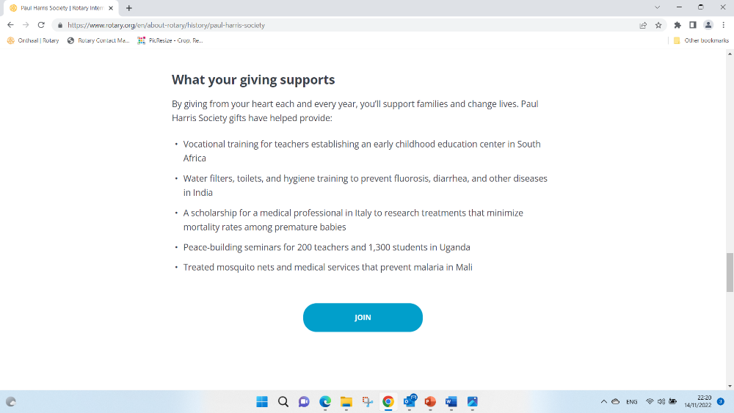
Hoe ?

Slide 17
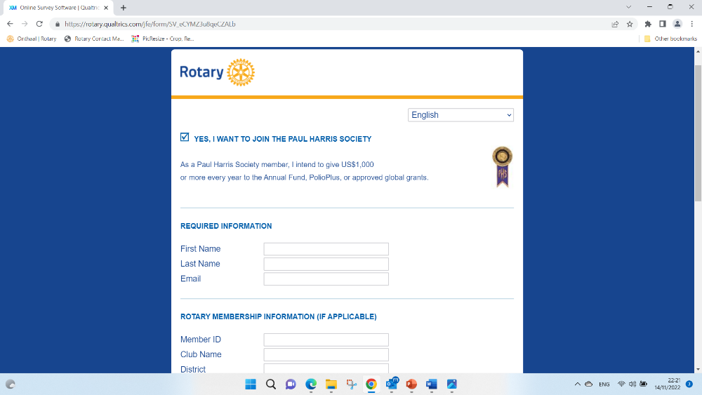
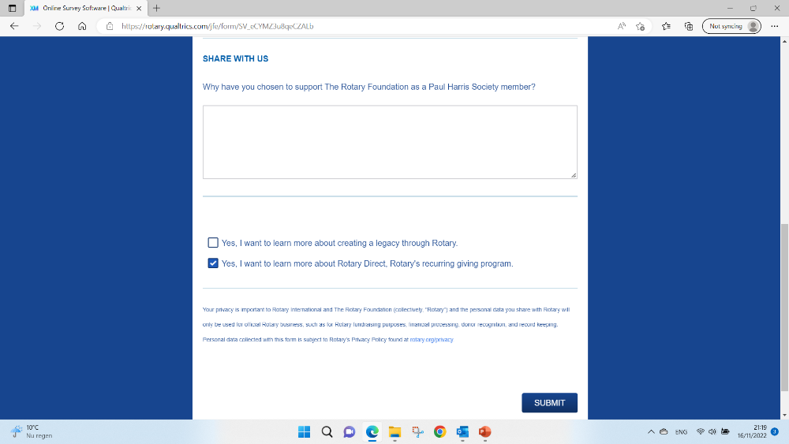
Hoe ?

Slide 18

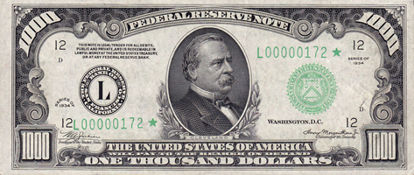


PAUl harris society en d2140
Opgericht in 2013
Rotariërs en niet-Rotariërs,
Jaarlijkse persoonlijke donatie van minstens $1.000 aan TRF
45% fiscale return via de Kon. Boudewijn Stichting
D2140: op 01/07/21: 19 leden
D2140: op 24/10/23: 33 leden
€1,23 per dag

Slide 20
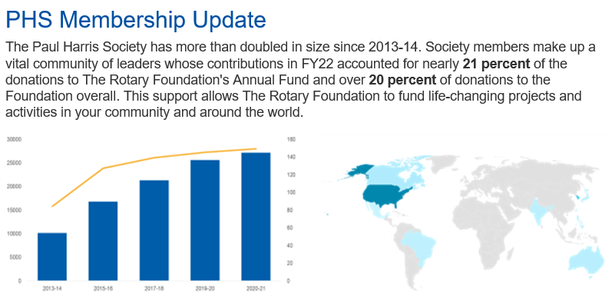

Slide 21

https://youtu.be/Oiz1Uz0AStg

Slide 22
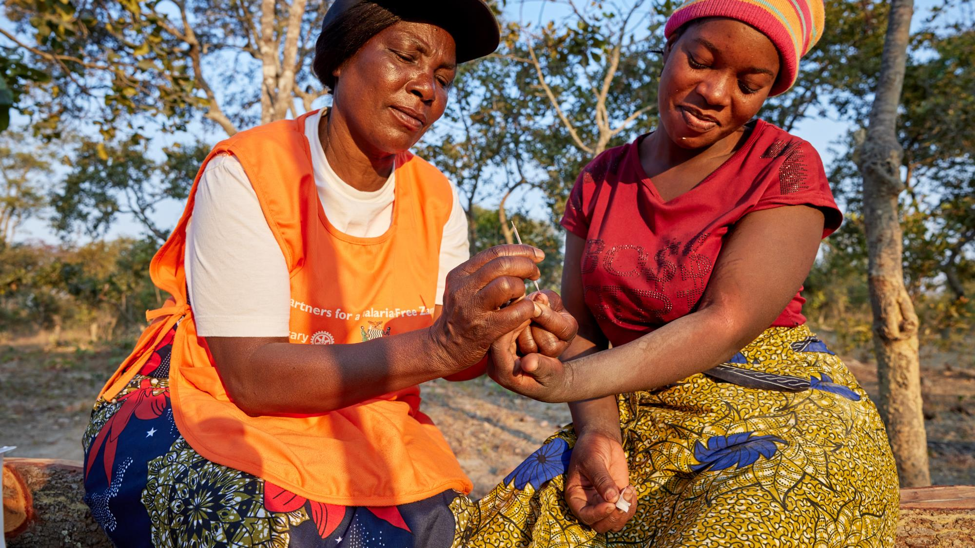
Thank you
Notes:
Thank you for your time, your leadership, and your support — and for trusting The Rotary Foundation to use your contributions to make a lasting difference.

Slide 23
Endowment Fund
Dominiek Willemse

Slide 24
subhead
GIVE NOW (duurzame impact)

Slide 25
subhead
GIVE FOR EVER
(endowment fund)

Slide 26


Slide 27
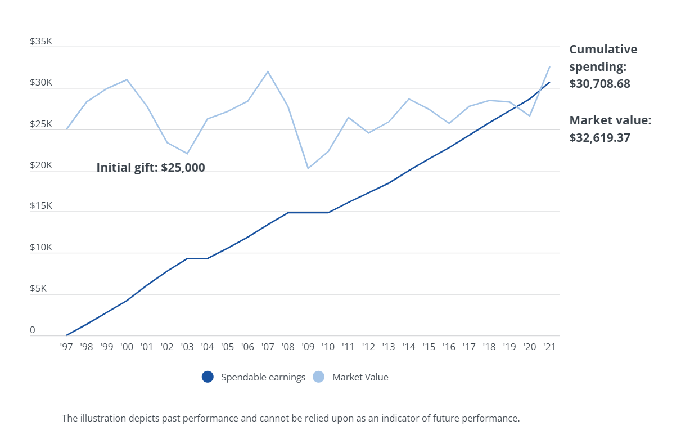
+ voor eeuwig verbonden aan uw naam.

Slide 28
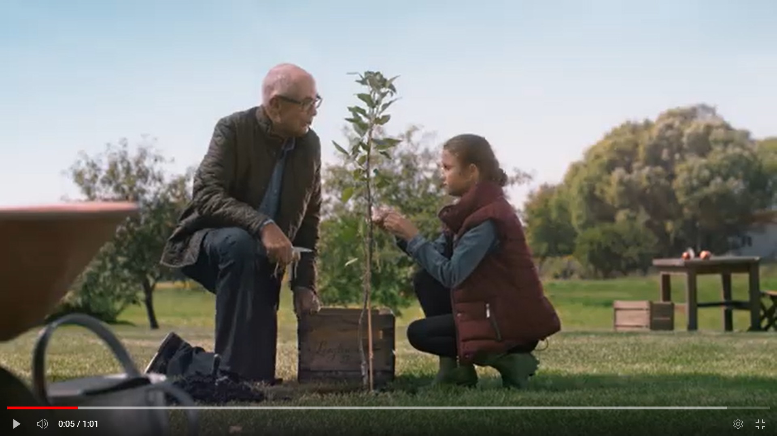
https://youtu.be/x-LxSFHyf1Y

